Slide 1
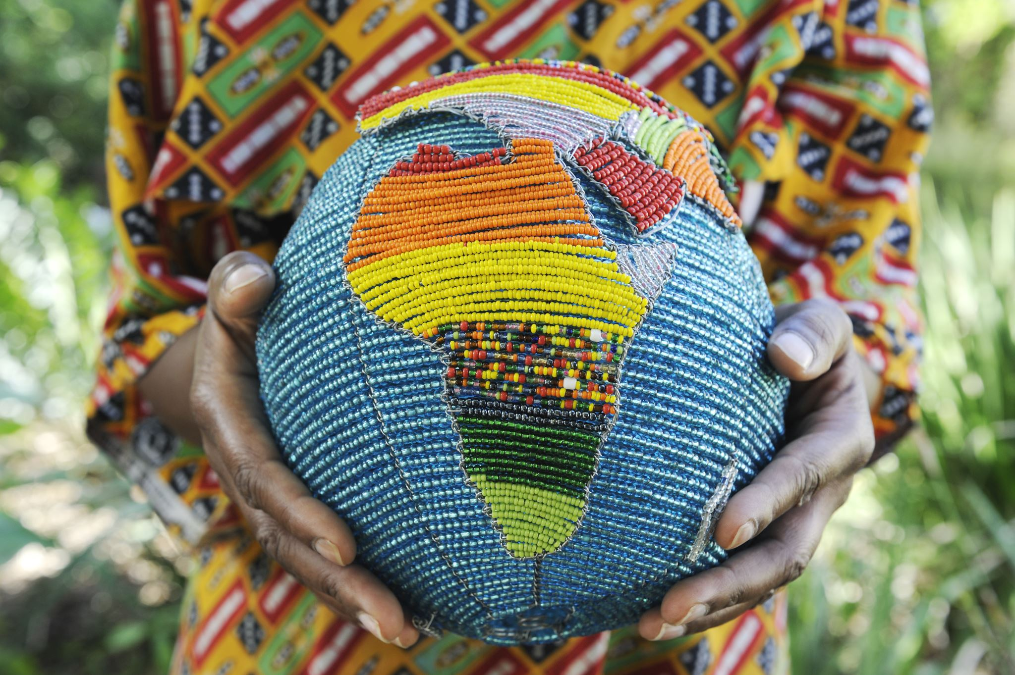

Micro- Nation ETL Project
Shaquiel Pashtunyar
DSC680

Slide 2
What is a Micronation
“Micronations, sometimes also referred to as model countries and new country projects, are small, self-proclaimed entities that claim to be independent sovereign states, but which are not acknowledged as such by any recognized sovereign state, or by any supranational organization.”
-Wikipedia

Slide 3
Proposal
E xtract and organize micronation from several internet pages
T ransform the data into a finalized table
L oad it into pandas data frame or Power BI to create insights

Slide 4
Extraction
Data taken from Wikipedia through a python package, beautiful soup.
Load the data from the pages in a total of 17 different tables/pages

Slide 5
Transform
Removal of flag field
Cleaned up start and end dates
Create a length of existence column
Label if they are in existence or gone
Load all the data into a central table

Slide 6
Load
Create several pandas pyplots
Load the data in an excel
Bring into PBI for data analysis

Slide 7
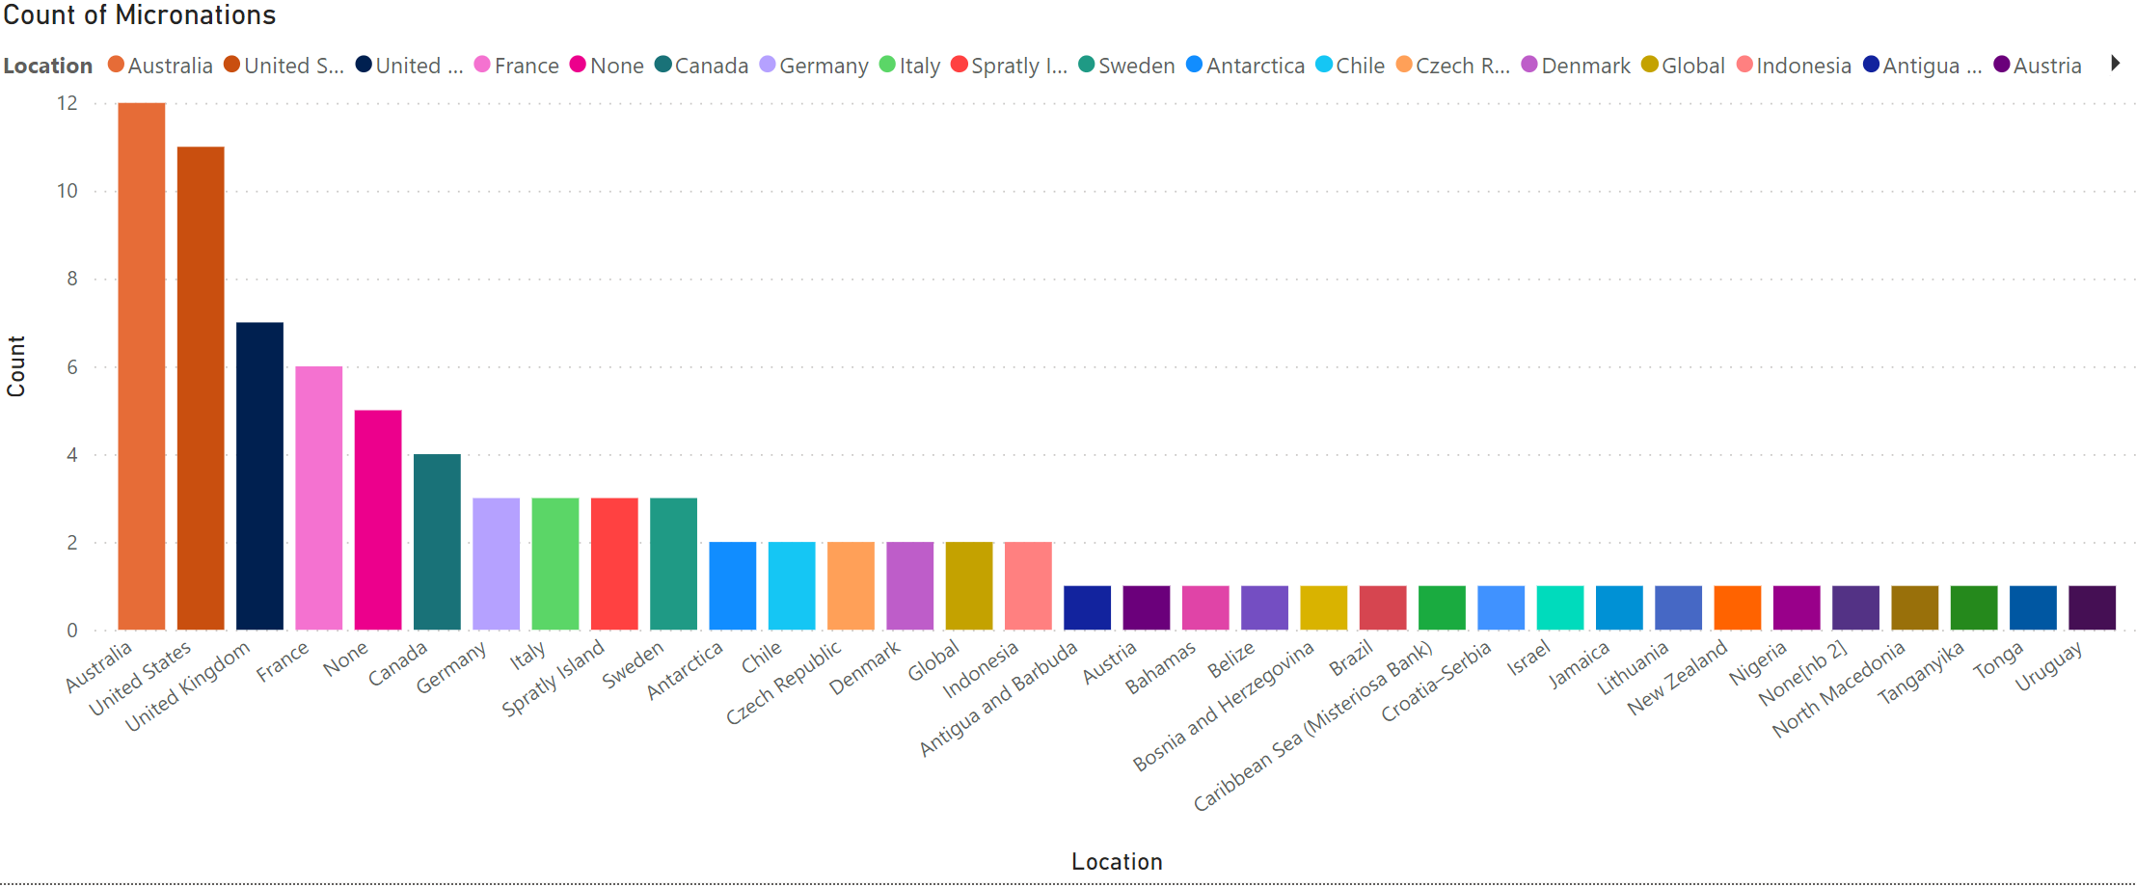
Count of Micronations

Slide 8
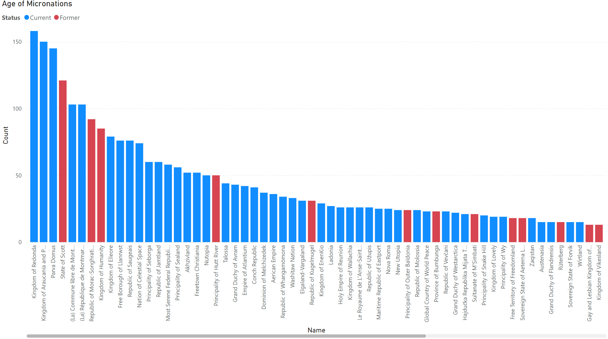
Age of Micronations

Slide 9
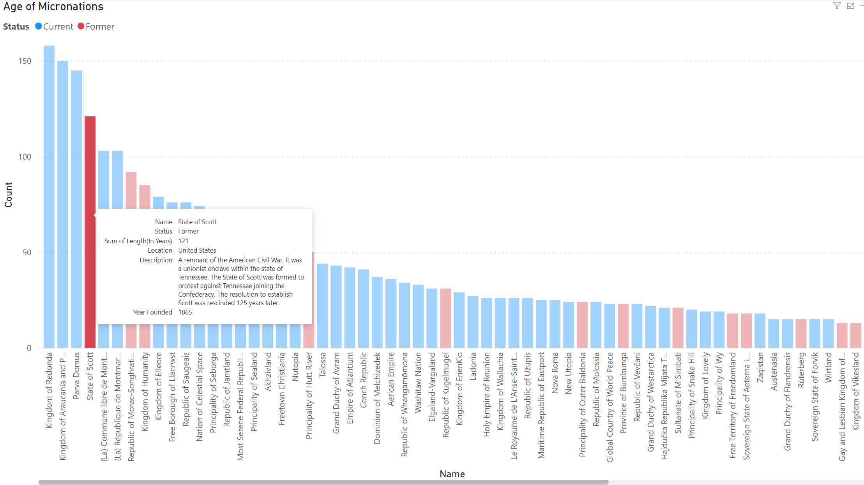

Slide 10
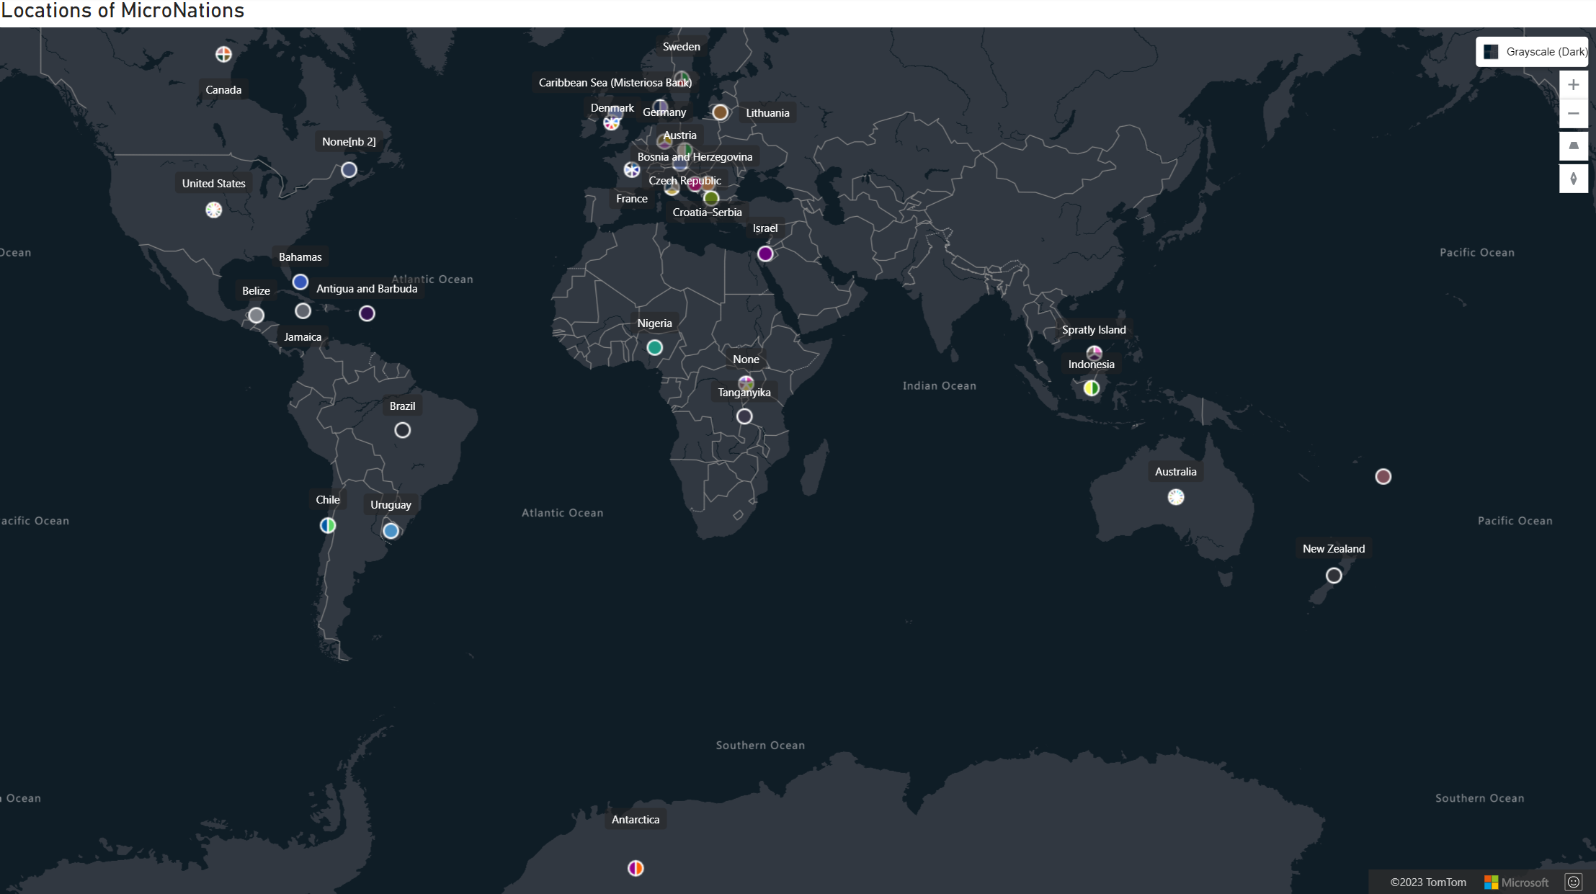

Slide 11
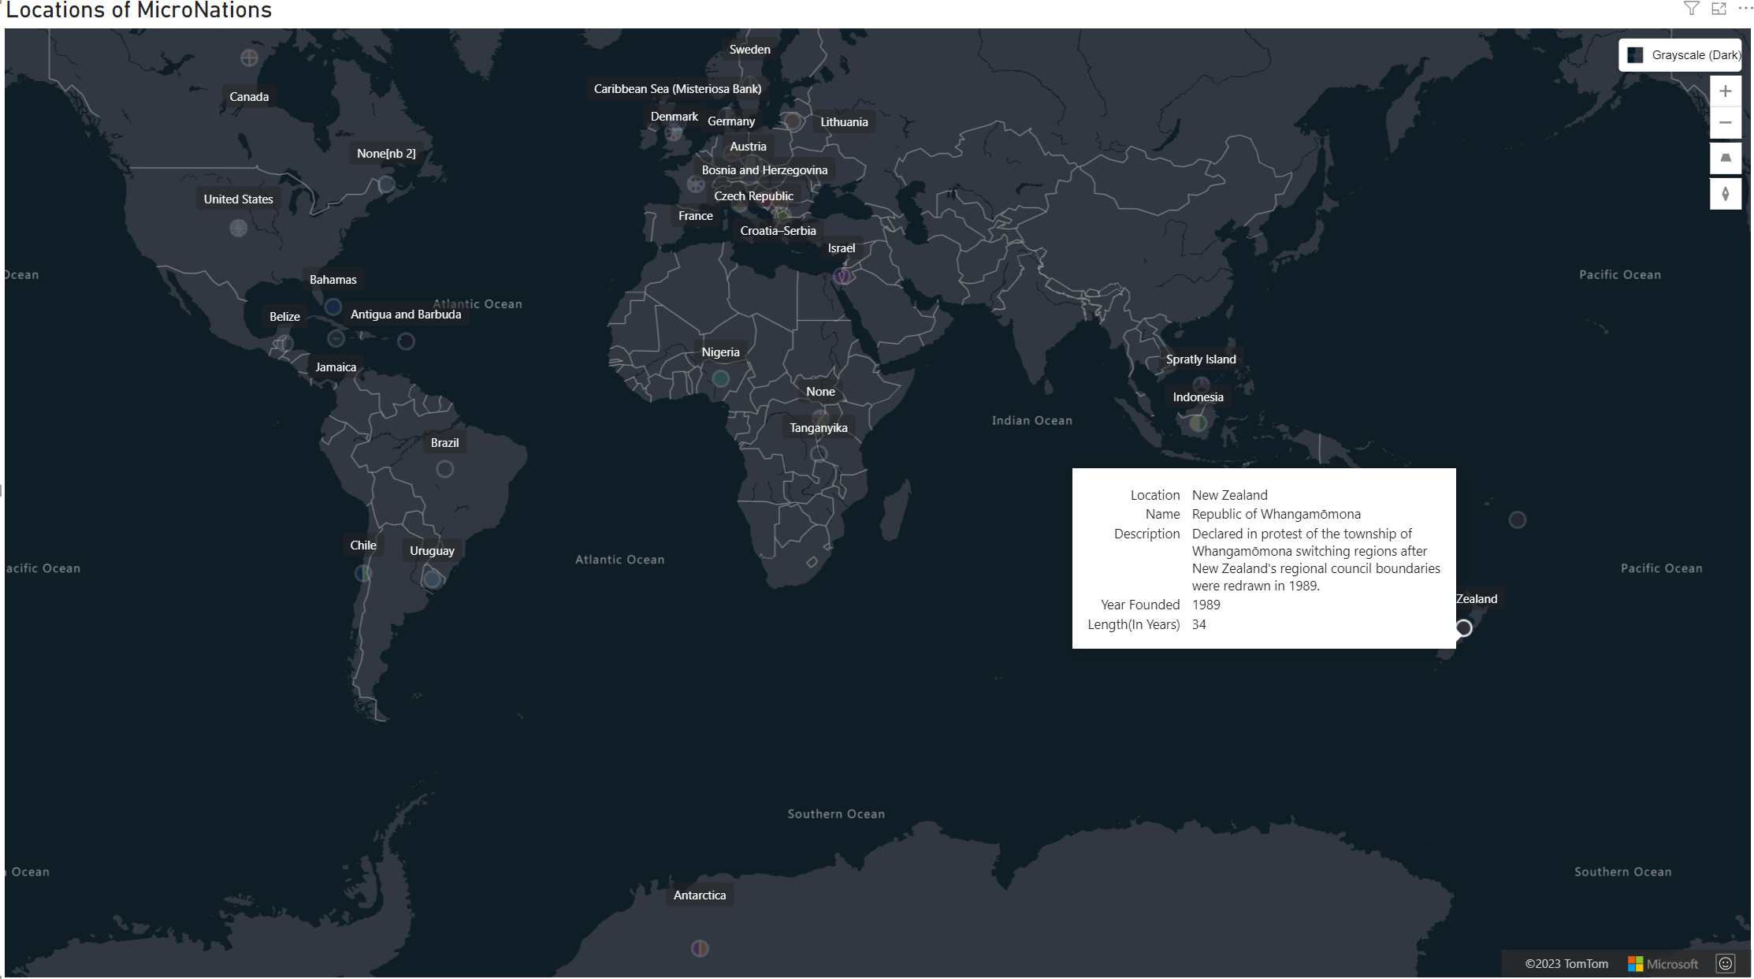

Slide 12
Conclusion
We were able to extract data from online sources, transform it to applicable and usable data, and create data visualizations to help understand the data.

